Slide 1
AI-Based Analysis of Social Media Data for Public Health Domain
Submitted in the partial fulfillment for the award of the degree of
BACHELOR OF ENGINEERING
IN
BIG DATA ANALYTICS
Submitted by:
Shubhanshu Pandey: 21BCS3854
Jatin : 21BCS3835
Shameem Ahmed: 21BCS3807
Sushil: 21BCS4228
Under the Supervision of:
Mr. Vijay Mohan Shrimal
(E17122)
Department of AIT-CSE
DISCOVER . LEARN . EMPOWER

Slide 2
Outline
Introduction to Project
Problem Formulation
Objectives of the work
Methodology
Design
Result and Output
Conclusion
Future Scope
References

Slide 3
Introduction to Project
Social media platforms have developed into an essential means of communication in the digital age, with billions of people interacting every day and exchanging thoughts, stories, and worries. This abundance of unstructured, real-time data presents previously unheard-of chances to enhance public health outcomes. Stakeholders in public health may turn this data into useful insights by utilising artificial intelligence (AI), namely Natural Language Processing (NLP) and machine learning. These revelations have the potential to transform health interventions, speed up the identification of new health issues, and simplify policy-making.
Understanding community behaviours, combating disinformation, and providing timely information during epidemics are just a few of the difficulties facing the public health field. Surveys and censuses, two traditional means of collecting health data, are frequently sluggish, resource-intensive, and geographically constrained. Social media sites like Facebook, Instagram, Reddit, and Twitter, on the other hand, provide real-time data that represents the opinions and experiences of many groups. AI is essential for deriving significant insights from this enormous and diverse data pool, but analysis of this data requires advanced tools and methodologies.

Slide 4
Problem Formulation
Social media platforms generate a huge amount of information daily, where people share their health concerns, opinions, and behaviours. However, this data is messy and too large to analyze using simple methods. Public health organizations struggle to quickly spot health issues like disease outbreaks, fight misinformation, or understand how people feel about health campaigns. This project aims to use AI tools, like language analysis and machine learning, to study social media data efficiently. The goal is to provide useful insights that help public health teams make better and faster decisions to improve health outcomes.
Social media holds valuable health-related insights, but its vast, unstructured data is difficult to analyze effectively. Public health teams face challenges in identifying trends, combating misinformation, and understanding public sentiment. This project uses AI to analyze social media data, providing actionable insights to improve health decisions and outcomes.

Slide 5
Objectives of the Work
The main goal of this project is to use AI to analyze social media data and improve public health strategies. Specifically, the project aims to:
Spot Health Trends: Identify health issues like outbreaks, mental health concerns, or behavior changes early.
Understand Public Opinion: Analyze how people feel about health policies, campaigns, or topics to make them more effective.
Fight Misinformation: Detect and address false health information spreading online.
Support Decisions: Provide clear insights and alerts to help public health teams make informed choices quickly.

Slide 6
METHODOLOGY
Data Collection – Extract relevant posts from platforms via APIs or scraping.
Preprocessing – Clean text (remove spam, normalize, handle slang/emojis).
Annotation – Label data for symptoms, misinformation, vaccine hesitancy, etc.
Sentiment & Topic Analysis – Use NLP for public sentiment and trend detection.

Slide 7
Misinformation Detection – AI models verify facts against trusted sources.
Trend & Network Analysis – Identify influencers, spread patterns, and regional insights.
Predictive Modeling – Forecast outbreaks and behavior shifts using ML.
Ethics & Privacy – Ensure GDPR, HIPAA compliance, and data anonymization.
Visualization & Reporting – Dashboards for real-time insights to health agencies.

Slide 8
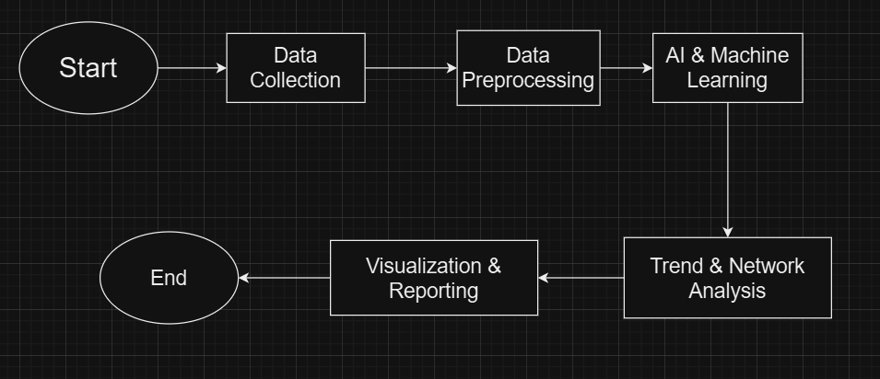
Design

Slide 9
Results and Outputs
The effectiveness of AI-based social media analysis for public health relies on accurate result interpretation and validation. Result analysis involves extracting meaningful insights from AI-generated outputs, while validation ensures the reliability and accuracy of these findings. This section outlines key methodologies for analyzing results, validating AI models, and assessing their impact on public health decision-making.
AI models generate vast amounts of data that require structured interpretation for actionable insights. The analysis focuses on identifying trends, anomalies, and correlations between social media discussions and public health indicators.

Slide 10
Conclusion
The application of AI-based social media data analysis in the field of public health signifies a paradigm change in our comprehension, observation, and handling of public health issues. This revolutionary technique has shown promise in several fields, such as public sentiment analysis, mental health monitoring, disinformation identification, and epidemic predictions. Real-time insights that were previously hard to gain using conventional data gathering methods are now available to researchers and public health officials using advanced AI techniques like natural language processing (NLP), machine learning (ML), and deep learning.

Slide 11
Future Scope
The application of AI-based social media analysis in public health is still evolving, and there are several areas for future research and development. While AI has already demonstrated its ability to track disease outbreaks, monitor mental health, and combat misinformation, many challenges remain.
Future research should focus on improving AI algorithms, addressing ethical concerns, integrating multimodal data sources, and enhancing collaboration between AI researchers, public health officials, and policymakers.

Slide 12
References
1. AI for Analyzing Mental Health Disorders Among Social Media Users: Quarter-Century Narrative Review of Progress and Challenges [J Med Internet Res 2024 Nov 15:26:e59225.doi: 10.2196/59225.]
2. Using AI–ML to Augment the Capabilities of Social Media for Telehealth and Remote Patient Monitoring[Healthcare(Basel)2023Jun 10;11(12):1704.doi: 10.3390/healthcare11121704]
3. Artificial Intelligence–Enabled Analysis of Public Attitudes on Facebook and Twitter Toward COVID-19 Vaccines in the United Kingdom and the United States: Observational Study[Published on 05.04.2021 in Vol 23, No 4 (2021): April]
4. Leveraging AI to connect social media discourse with public health trends[Ding, X., et al. (2024). Leveraging Prompt-Based Large Language Models: Predicting Pandemic Health Decisions and Outcomes Through Social Media Language. CHI '24: Proceedings of the CHI Conference on Human Factors in Computing Systems. doi.org/10.1145/3613904.3642117.]
5. Informing social media analysis for public health: a cross-sectional survey of professionals[Published: 02 January 2024].

